Slide 1
THE INDIAN CENSUS ANALYSIS SQL PROJECT
PROJECT BY ANANT DEEP SRIVASTAVA

Slide 2
Project Description:
Title: Analysis of Indian Census Data
Description: This project involved analyzing Indian census data to derive insights into various demographic factors across different states of India. The dataset comprised two main tables: Data1 and Data2, containing information about states, population, literacy rates, sex ratios, growth rates, and other demographic indicators.
Key Objectives:
Determine the total population of India.
Calculate the average growth rate of India.
Analyze the average growth rate and sex ratio by state.
Identify states with high literacy rates.
Determine the top and bottom states based on average literacy rates.
Extract states starting with specific letters or meeting certain criteria.
Technologies Used:
SQL: Structured Query Language was used to query and analyze the dataset stored in a relational database.
Microsoft SQL Server Management Studio: Used as the IDE for writing and executing SQL queries.
Data Visualization Tools: Charts and graphs could be created using various data visualization tools to visually represent the insights derived from the analysis.
Outcome: The analysis provided valuable insights into the demographic landscape of India, highlighting variations in population, literacy rates, sex ratios, and growth rates across different states. These insights could be useful for policymakers, researchers, and organizations working in various sectors such as healthcare, education, and urban planning.

Slide 3
MY LEARNINGS FROM THIS PROJECT
Through my project on Indian census data, I embarked on a comprehensive journey of learning SQL. I delved into key concepts like SQL functions, temporary tables, ORDER BY, GROUP BY, and joins. Leveraging functions such as AVG(), SUM(), and ROUND(), I efficiently computed crucial metrics like average growth rates and total population. Temporary tables (#topstates and #btmstates) emerged as indispensable tools, aiding in organizing and manipulating intermediate data subsets effectively. Employing ORDER BY and GROUP BY clauses, I gained insights into sorting and aggregating data, while joins like INNER JOIN facilitated the consolidation of data from multiple sources for holistic analysis. This project not only deepened my understanding of SQL fundamentals but also honed my practical skills for data analysis in real-world scenarios.

Slide 4
KEY INSIGHTS FROM THE PROJECT
From the project on Indian census data, several policy insights emerged:
Regional Disparities: Analysis revealed significant variations in demographic indicators across states, highlighting the need for region-specific policy interventions to address disparities in areas such as literacy rates, sex ratios, and population growth.
Education Initiatives: States with low literacy rates, such as Bihar and Jharkhand, require focused efforts to improve educational infrastructure and access to quality education, aiming to uplift overall literacy levels and empower communities.
Population Management: Understanding population trends and growth rates is essential for formulating effective population management policies, including family planning initiatives and healthcare provisions tailored to the needs of different states.
Gender Equity: States with low sex ratios warrant targeted interventions to address gender imbalances, promoting gender equality through initiatives aimed at empowering women, enhancing female education, and addressing societal biases.
Economic Development: Recognizing the correlation between literacy rates, population growth, and economic development, policies promoting education, skill development, and employment opportunities can contribute to sustainable economic growth and social progress.

Slide 5
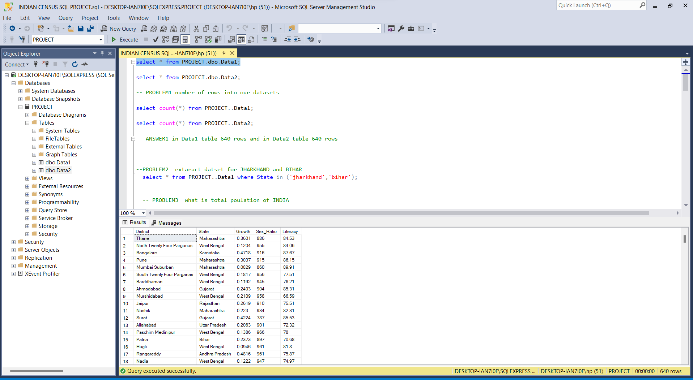

Slide 6
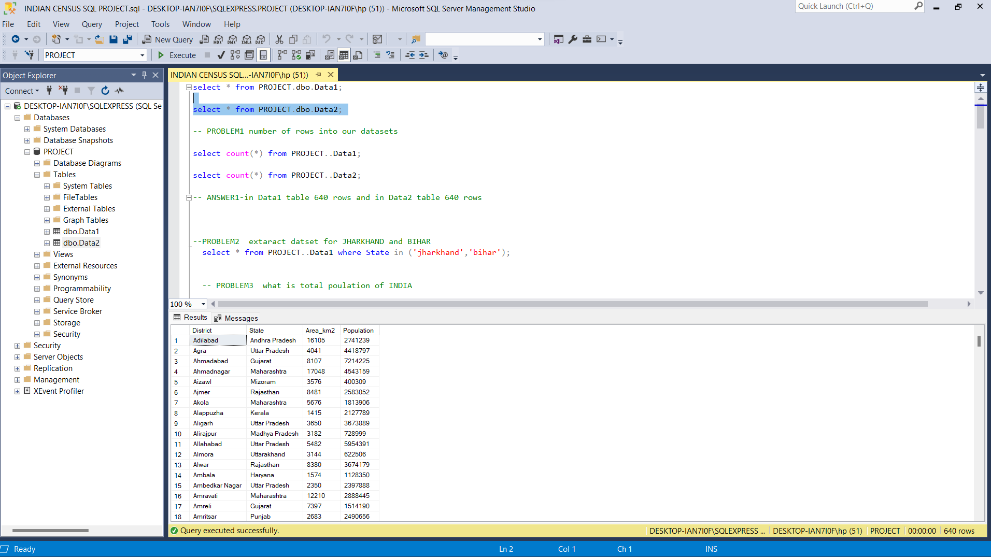

Slide 7
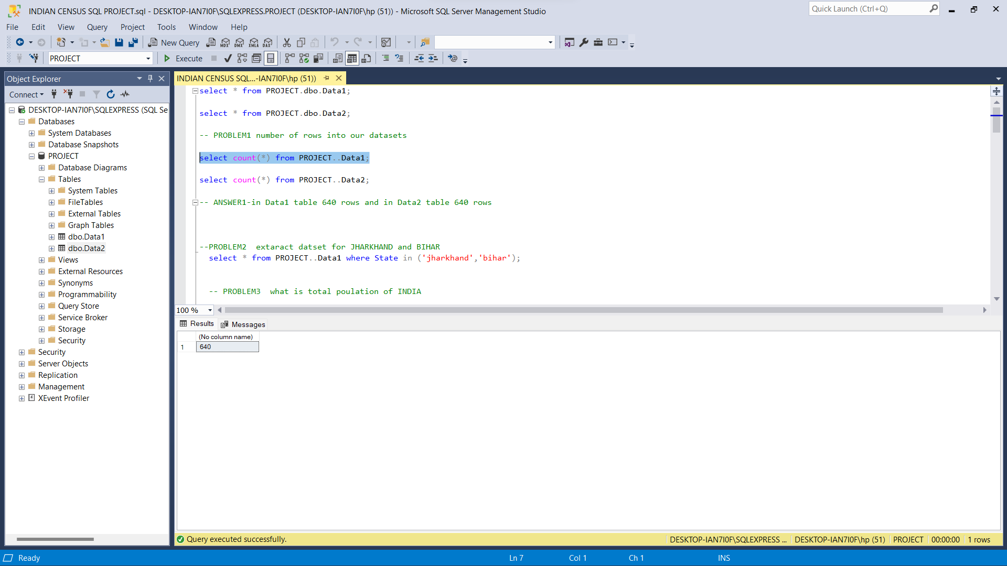

Slide 8
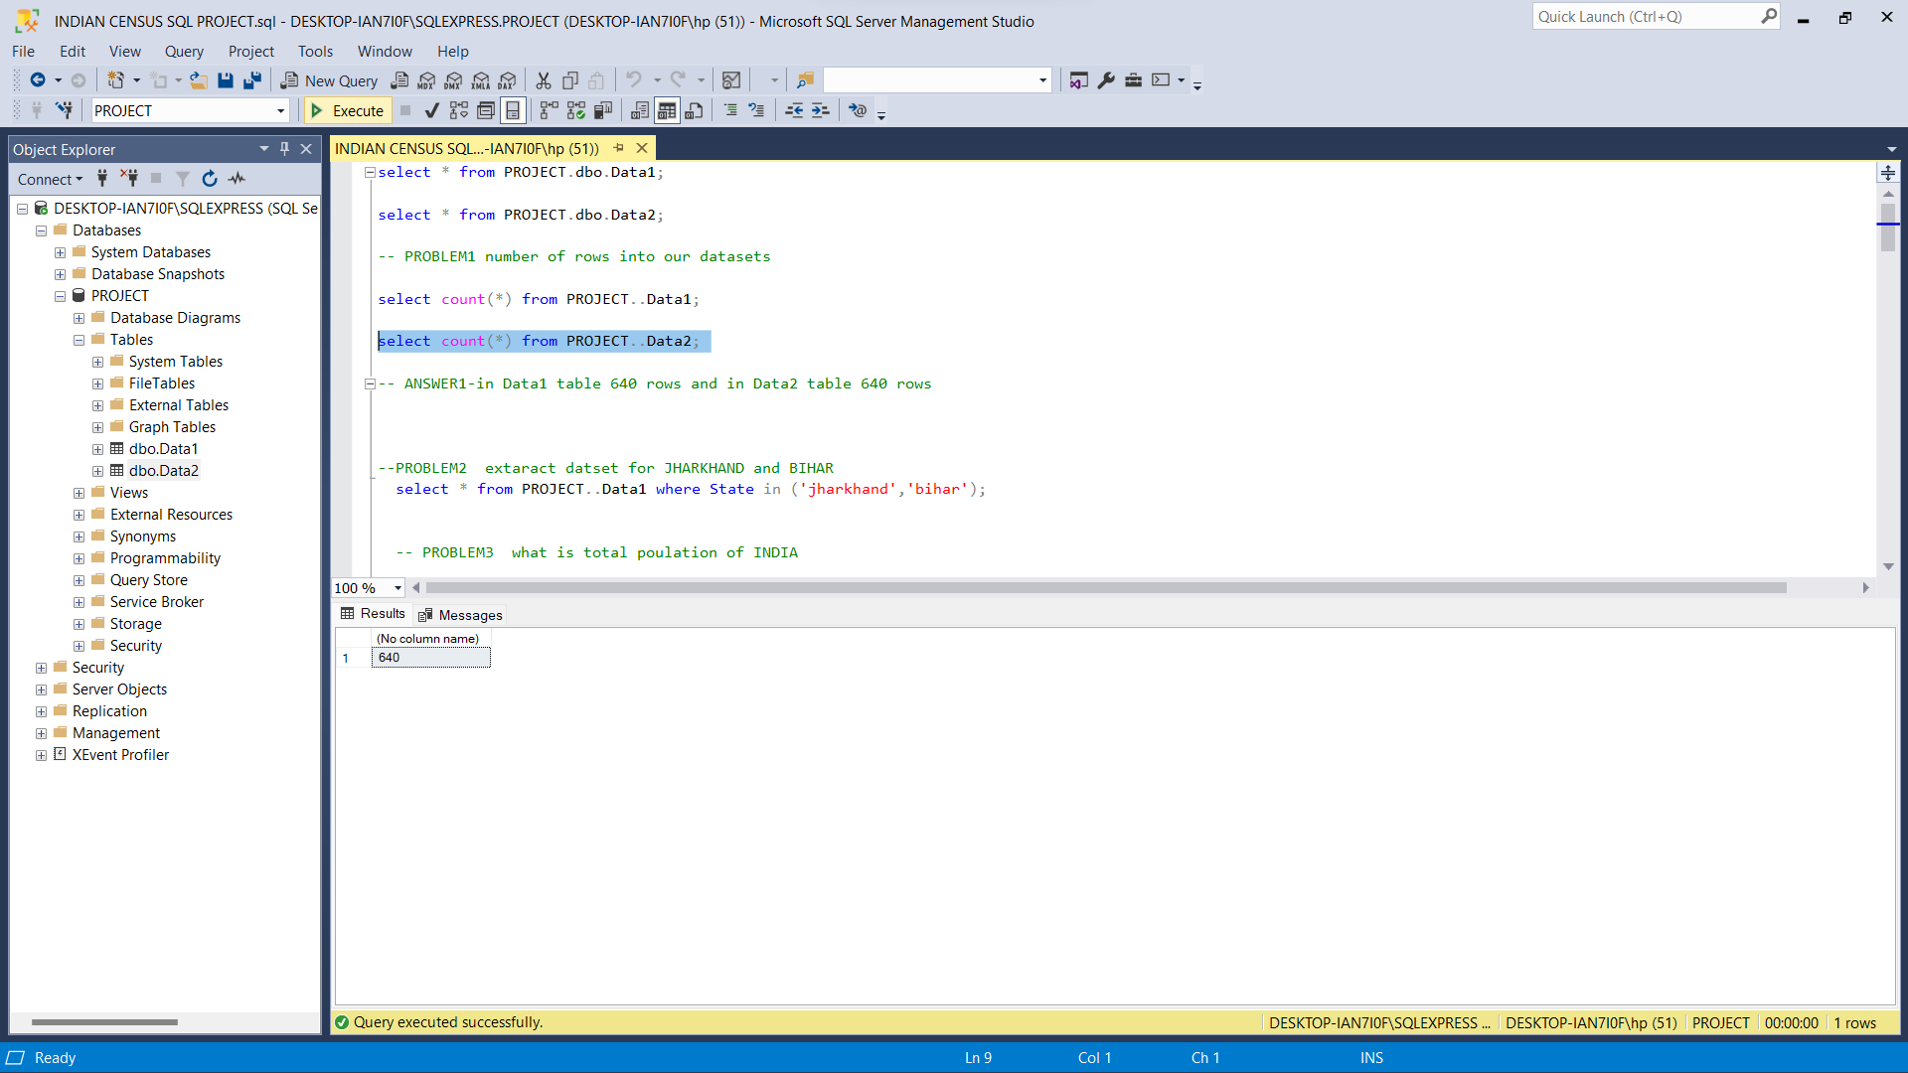

Slide 9
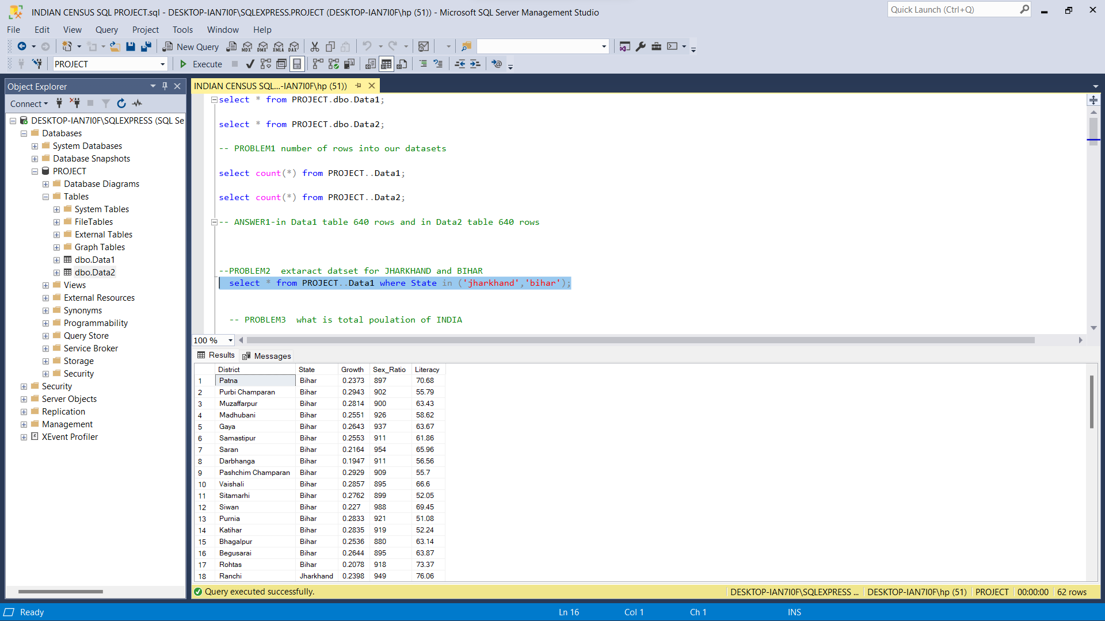

Slide 10
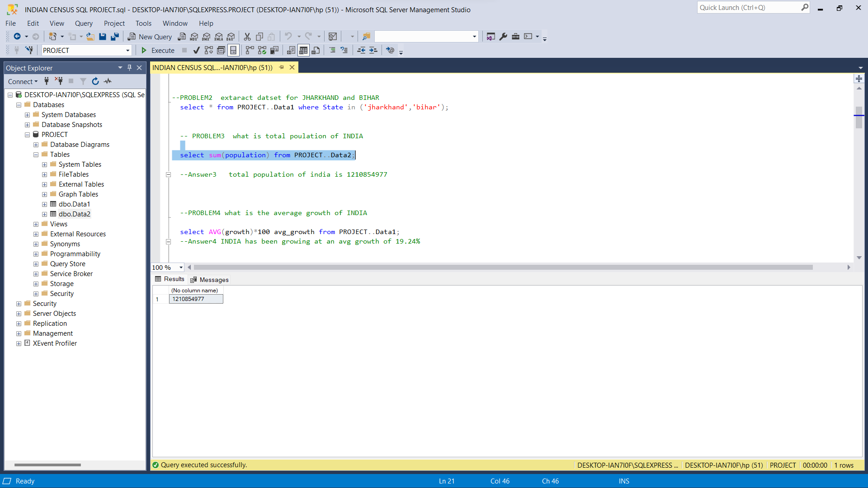

Slide 11
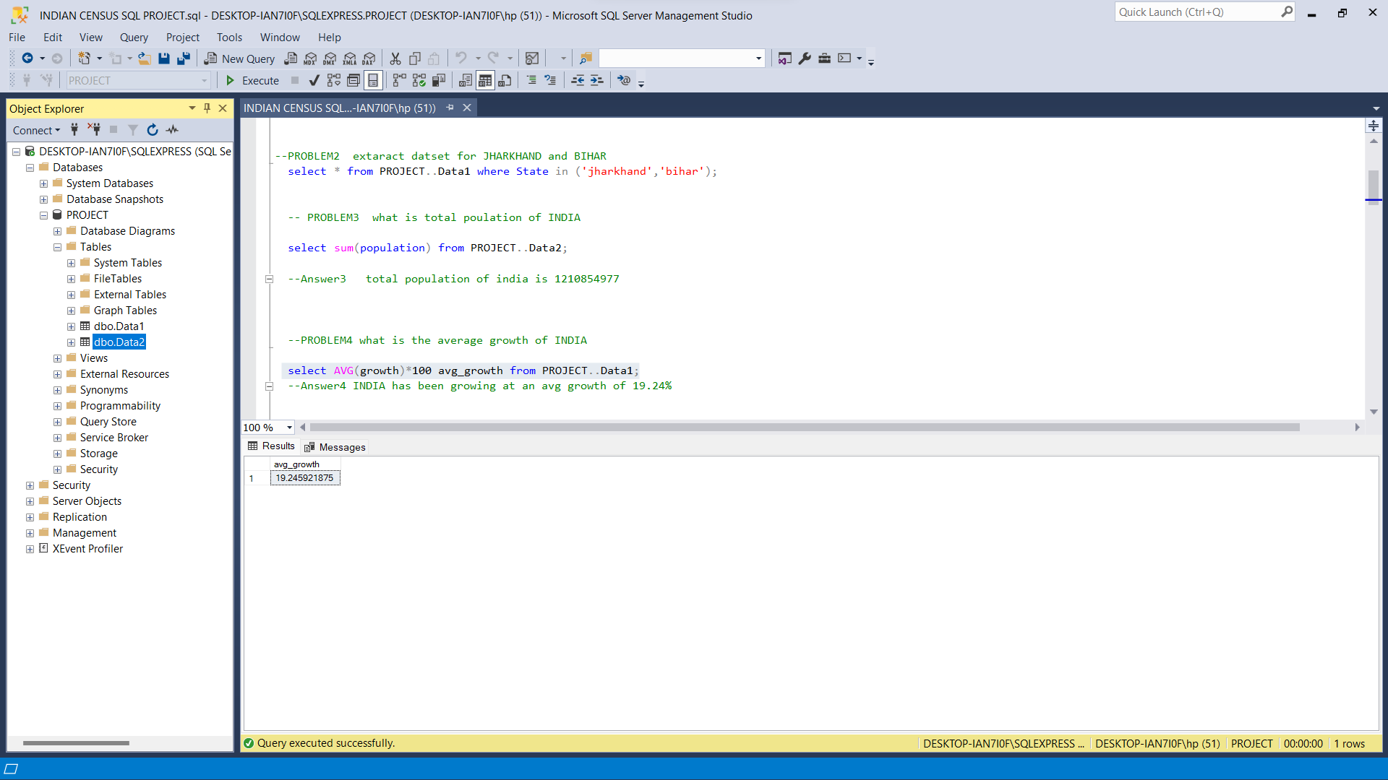

Slide 12
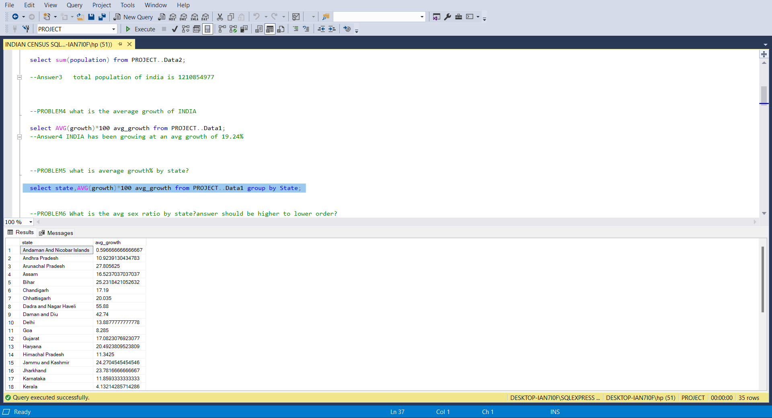

Slide 13
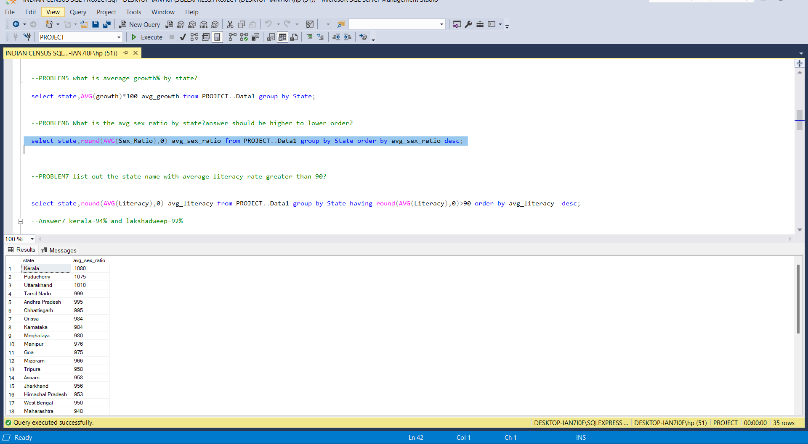

Slide 14
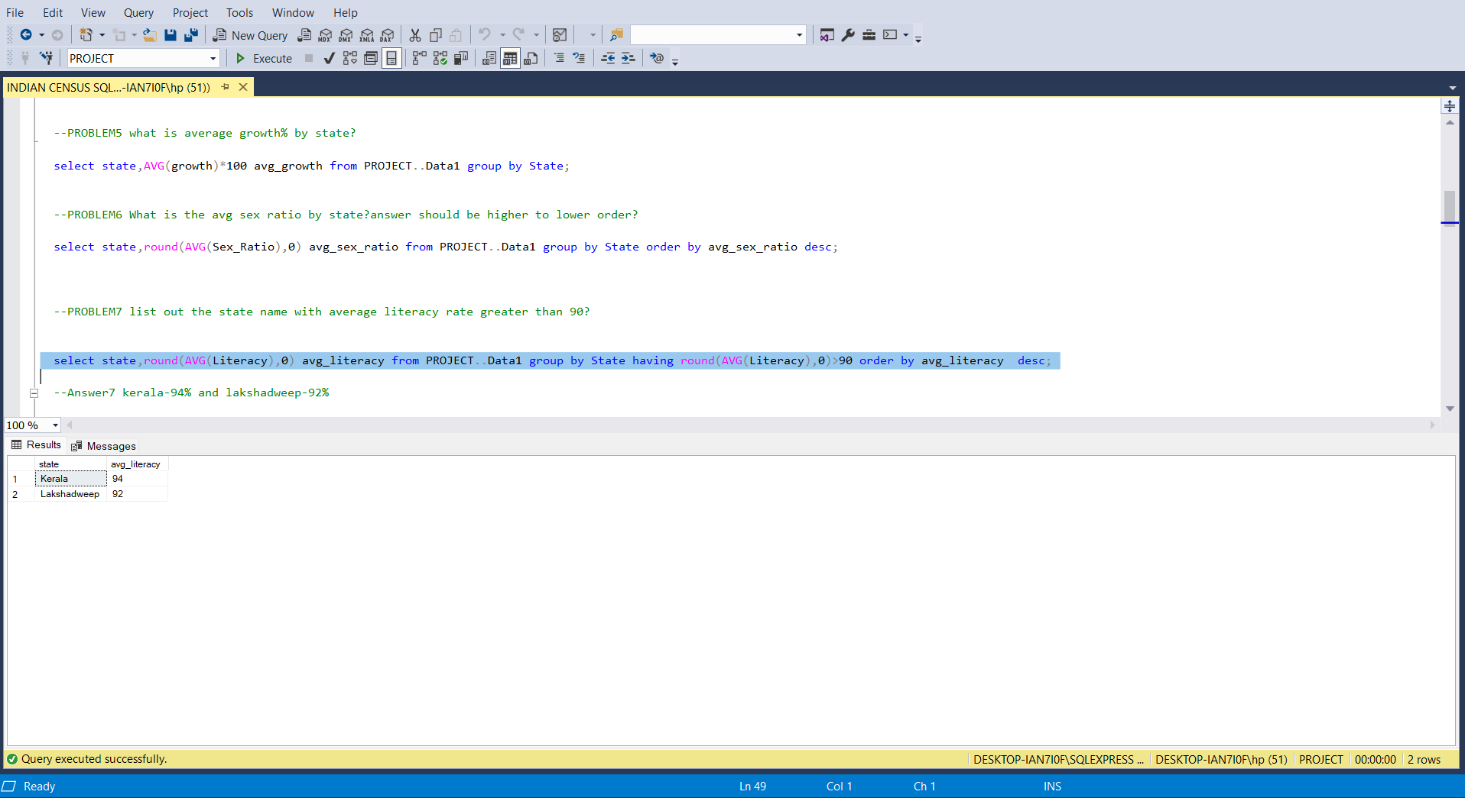

Slide 15
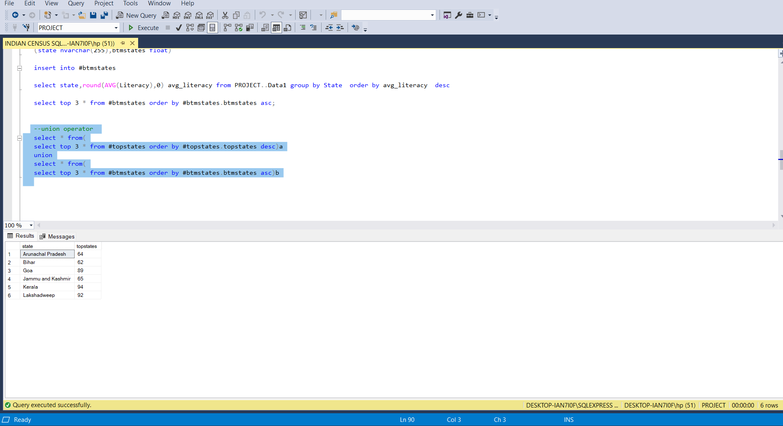

Slide 16
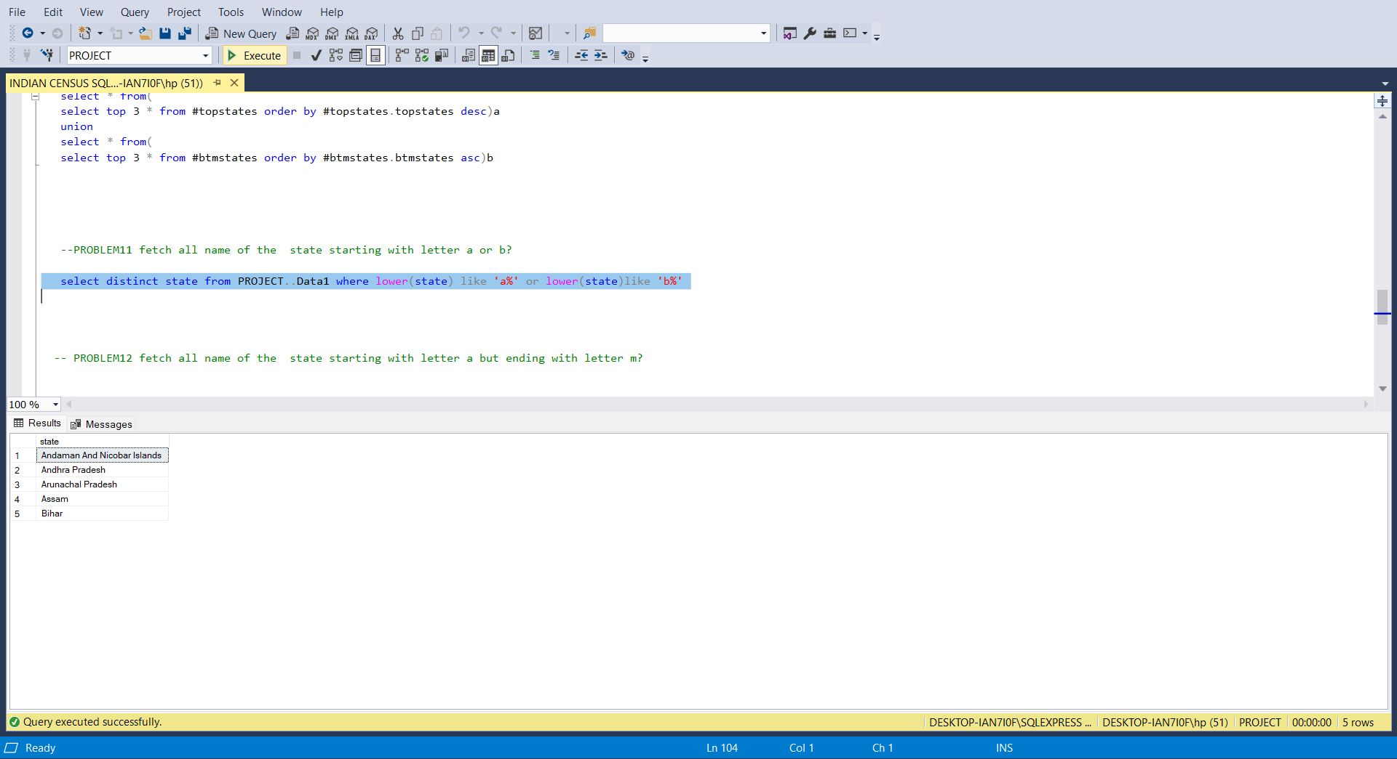

Slide 17
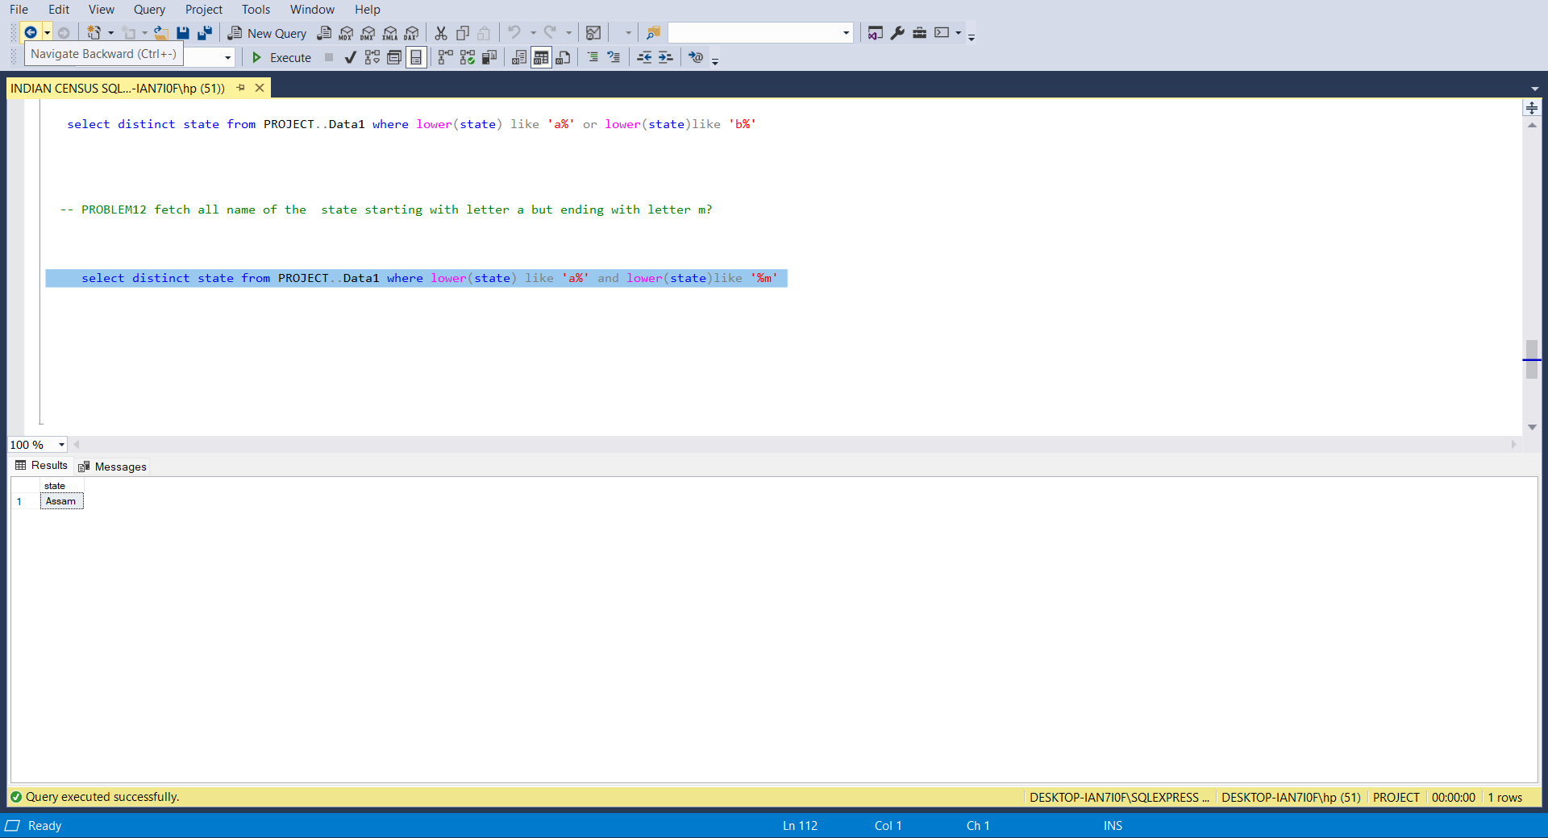

Slide 18
THANK YOU

